Slide 1
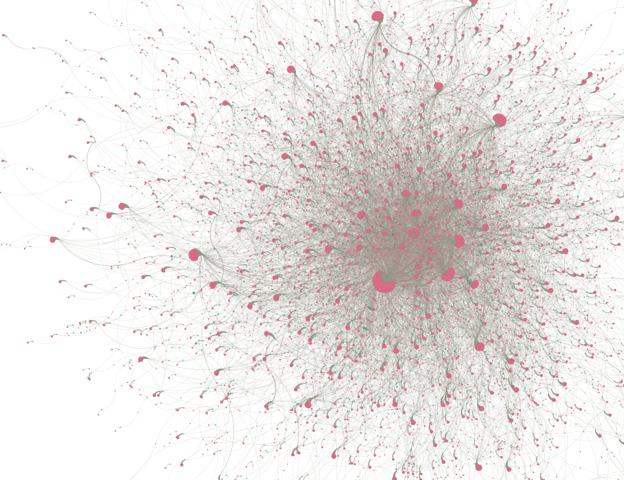
Hypergraph Anomaly Detection
Deven Biehler
Sai Kolagani
Notes:
Welcome to our project.
This is a collaborative project between the two of us to apply existing hypergraph learning models, which we suspected were currently underrepresented in the current landscape for anomoly detection methods.

Slide 2
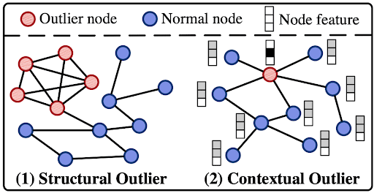
Anomaly Detection
Two types of outlier data when it comes to graph data.
Notes:
Anomoly detection is an old problem with great incentive for research as it is a crucial tool for protecting users from spam, scams, and hackers.
There are two kinds of outlier detection when it comes to network anomalies, first is the structural outlier, this is when a node or cluster of nodes appears to have a different structure than the overall network.
The second is the classic contextual outlier which comes from the context of the observation. In other words, it is an outlier based on the content of one node when compared to the usual content of a node in the network.

Slide 3
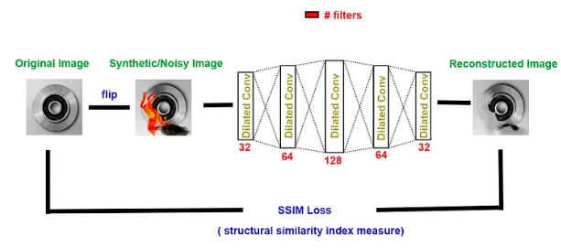
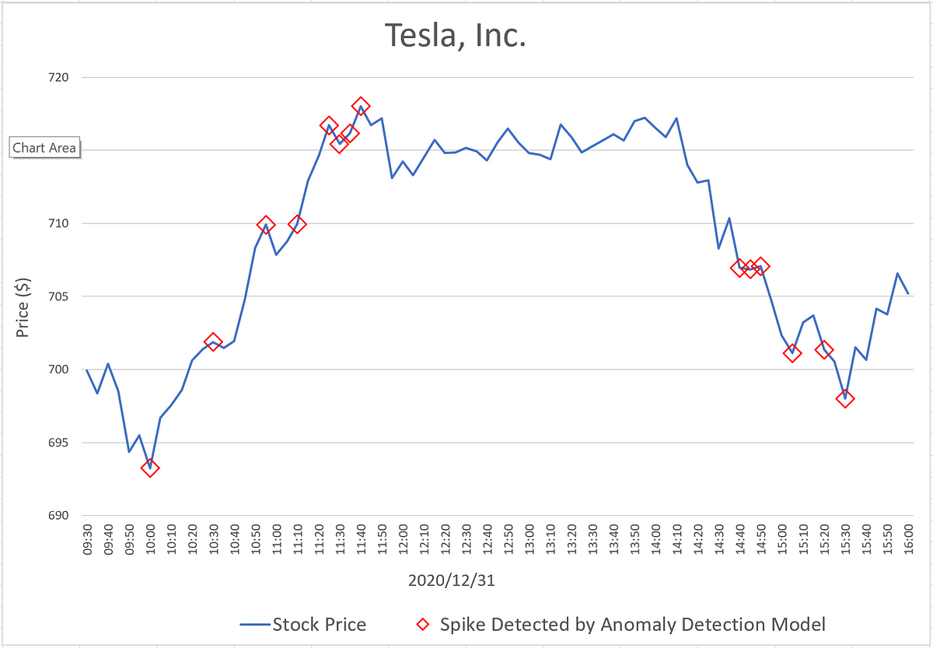
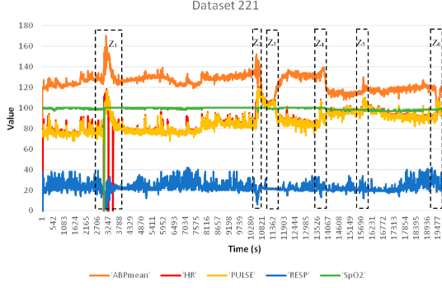
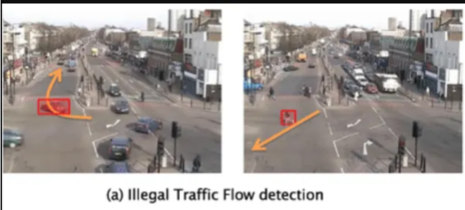
Anomaly Detection
Anomalies are everywhere
Notes:
Anomaly detection is an old field and yet new techniques are being developed every day.
Anomaly detection is also extremely important to many fields such as, stock tracking, healthcare, image reconstruction, anomaly detection in images.

Slide 4
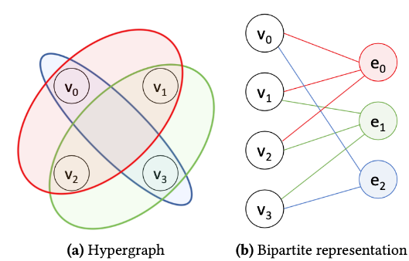
Hypergraphs
Bipartite graphs can be converted to hypergraphs.
Notes:
Hypergraphs are a special type of graph, developed to observe the higher order structure of a graph. While every graph can be converted to a hypergraph using convolution or other methods, a bipartite graph can be converted without losing any information from the original graph. For this project, we selected two datasets that has bipartite structures that could be converted to hypergraphs.

Slide 5
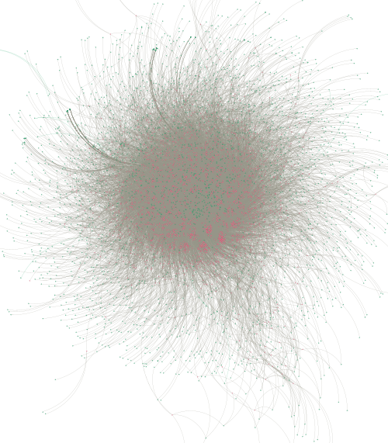
Anomalous User Detection
On Reddit Dataset
Notes:
The first dataset we approached was a basic user to web forum database from Reddit.com that had a user ID, forum ID, message and timestamp.
This dataset was chosen for its simplicity in understanding since social media is something that everyone is very familiar with.
This screenshot is a zoomed out view of the reddit dataset.

Slide 6
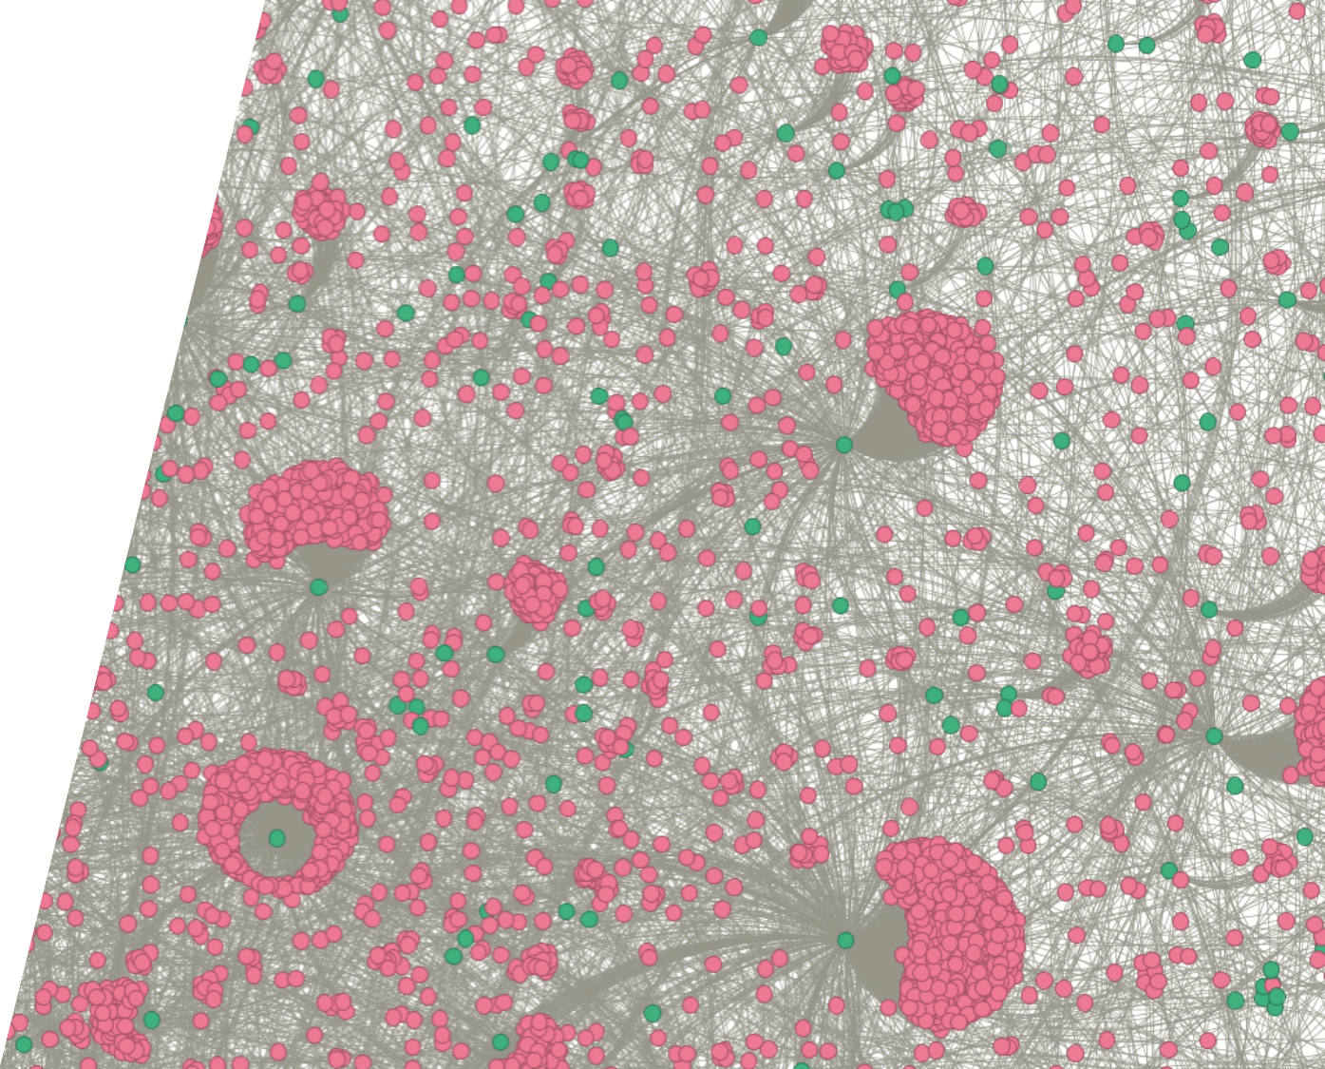
Bipartite Network
Database analyzed was reddit-user to reddit-forum interaction represented as a bipartite network.
Notes:
This graph is a closer look at the network on the last slide.
These interactions form a bipartite network between user and forum.
The green nodes are forums, while the pink are the users and edges are every interaction with the form through a comment or a post.

Slide 7
Anomaly Injection
Injecting anomalies to generate labeled data.
Dataset | Anomalies
"The guy is a professional, and very good at what he does. I highly doubt he misses often, if at all." | "re : valero gas marketing ; meter # : 8018 / sitara ticket #148376 please zero out the volumes until further notice ."
"This is a great question, and I want to thank you for asking it. However, I don't have any answers. I’m interested in learning more myself. " | "registration confirmation from spinner.com thank you for joining spinner . com : the web ' s largest source of free streaming music"
"I wish the kit they made for this was still available. " | dont sieep on this stock ! this is a hot one !"
Notes:
Here is an example of anomalies when it comes to our dataset.
As you can probably tell, even though the text from both datasets is random, the original dataset is much more coherent.
These anomalies were randomly inserted into the dataset and labeled for the training of the model.

Slide 8
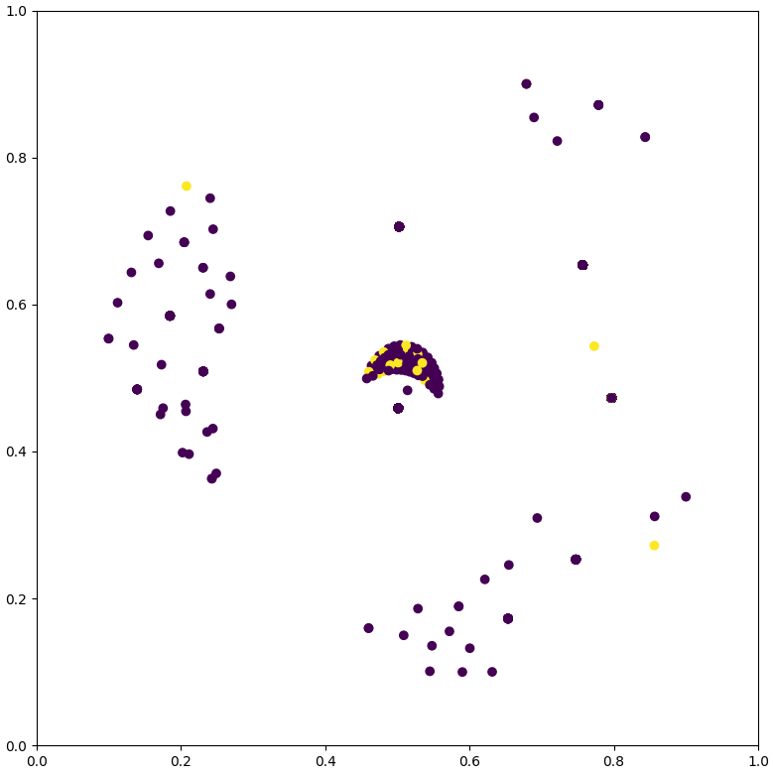
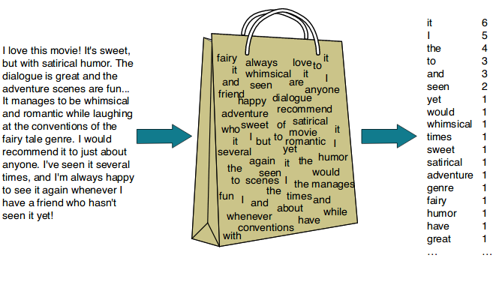
Features
Features for interactions were selected using a bag of words vectorization.
Notes:
Now we talk about the features selected for the learning process.
Features were generated for each user based on a conglomeration of their messages.
Their messages where then vectorized using a bag of words approach where a list of numbers represent the number of times each word was used.
This helps to identify anomalous users, since they are more likely to use unusual words, or use similar words as other anomalies.
In this visualization of the feature space, its easy to see that a number of entries in the dataset do not fit nicely with the rest.

Slide 9
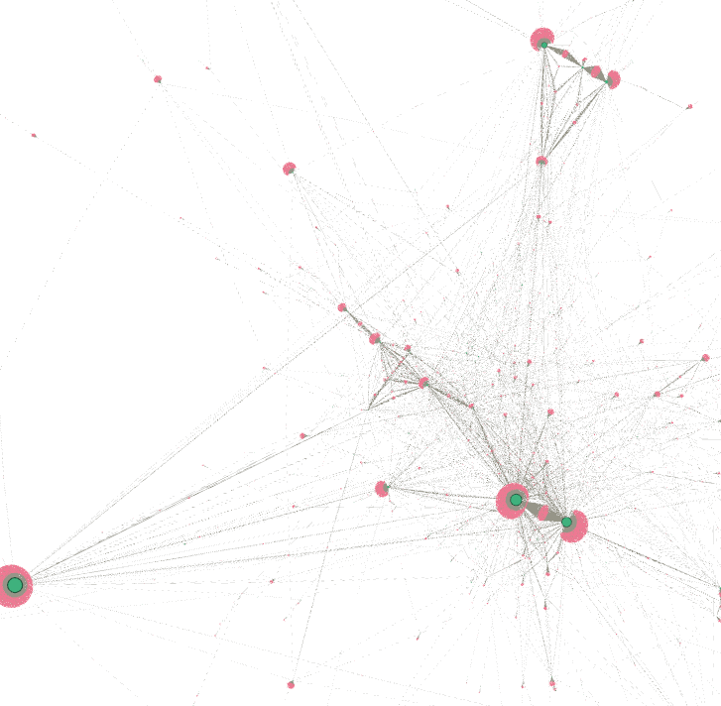
Anomalous Transaction Detection
On Financial Fraud Semi Supervised Dataset
Notes:
This was the second dataset tested with this method. We picked this method because it has been extensively studied and had an overall low accuracy with the top anomaly detection method called GTAN (Gated Temporal Attention Network).
This is a visualization of that dataset.

Slide 10
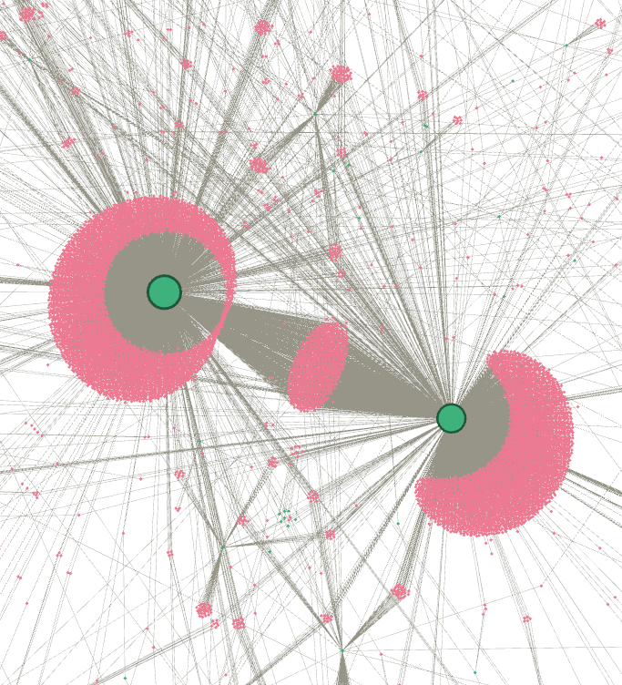
Bipartite Network
Transactions were formed into a bipartite network with the same method of sender – receiver interactions
Notes:
A similar method was proposed for this dataset as hyper edges could be represented as the merchants and the nodes could be the sender.
This dataset is a popular one to use for this task because its pre-labeled and has been inspected by professionals in the field to confirm the labels.

Slide 11
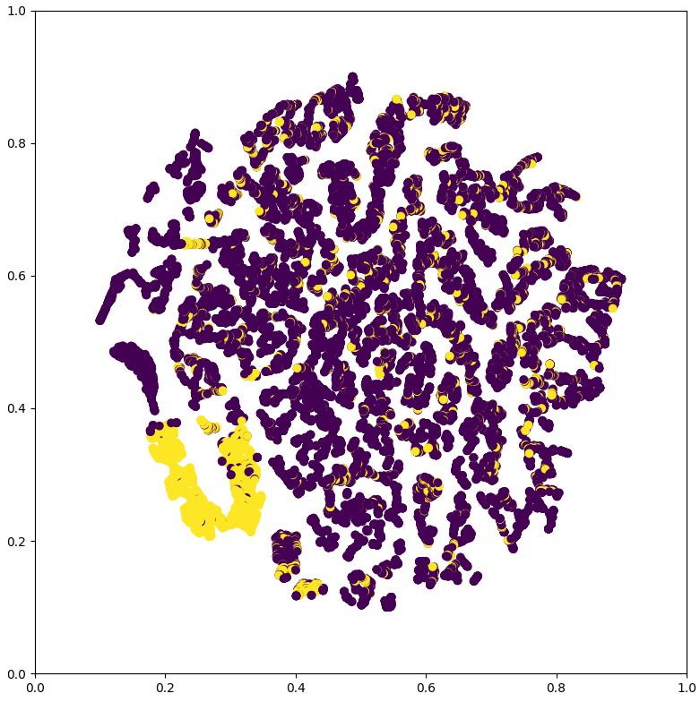
Features
Features were selected using the following metrics:
Sender, Amount, Time, Location, and Transaction Type
Notes:
The features for this dataset were selected differently than the reddit dataset. This is because the content of the transactions are different. The features used for the transaction dataset are Sender ID, Amount, Time, Location, and Transaction type.

Slide 12
Deep hypergraph Model
Spectral Convolution on Hypergraph:
HGNN defines a spectral convolution operation on the hypergraph structure, inspired by graph convolutional networks.
Hyperedge Convolution Layer:
HGNN introduces a hyperedge convolution layer.
Neural Network Training:
The hyperedge convolution layer is used as a building block in a neural network architecture.
Multiple such layers can be stacked, with non-linearities applied in between, to build a deep HGNN model.
Notes:
Without going too far into the technical details, here is a breakdown of HGNN
HGNN defines a spectral convolution operation on the hypergraph structure, inspired by graph convolutional networks.
HGNN introduces a hyperedge convolution layer that performs the convolution operation defined in step 1.
The layer takes a hypergraph signal (feature matrix) X as input and produces a new signal Y as output.
The hyperedge weights W are also learned during training, allowing the model to capture varying importances of different hyperedges.
The hyperedge convolution layer is used as a building block in a neural network architecture.
Multiple such layers can be stacked, with non-linearities applied in between, to build a deep HGNN model.
The training objective is typically a supervised loss function for a specific task, such as node classification or regression on the hypergraph data.

Slide 13
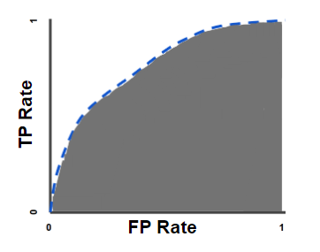
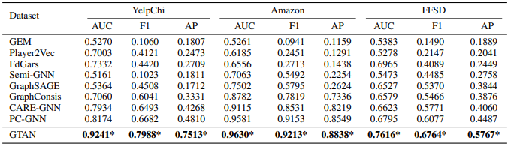
Results
 | Accuracy | F1 Score | AUC Score
Reddit | 0.9607 | 0.7947 | 0.9599
FFSD | 0.8451 | 0.6374 | 0.6946
Notes:
Accuracy is actually quite a terrible measurement for anomaly detection, for the fact that the data is severely imbalanced. Most machine learning algorithms designed for classification assume that there is an equal number of examples for each observed class which is rarely the case in real life.
The F1 score is a useful metric for evaluating the performance of a classification model, especially when there is an imbalance between the classes or when you want to consider both precision and recall.
AUC (Area Under the Curve) is an excellent way of comparing models independent of external variables in the model
The AUC can be interpreted as follows. It is the probability that the test will give a higher value for a randomly chosen individual who is an anomoly than a randomly chosen individual who does not have an anomoly.
A rough rule of thumb is that the accuracy of tests with AUCs between 0.50 and 0.70 is low; between 0.70 and 0.90, the accuracy is moderate; and it is high for AUCs over 0.90.

Slide 14
Applications
The implications of our findings extend to various real-world applications:
Enhanced cybersecurity measures, including fraud detection and intrusion prevention.
Improved financial monitoring and risk management in banking and finance.
Enhanced anomaly detection in healthcare, IoT, and social media platforms.

Slide 15
Future Work
Dynamic network
S-line graph
New dataset
Unsupervised and semi-supervised
Scalability
And much more…
Notes:
Use of temporal dynamics in hypergraphs can bring a new dimension of information to the model. Models that support changing of nodes and edges over time potentially have a huge advantage.
S-line graphs are a graph-like model of a hypergraph, where hyper-edges become nodes and shared nodes in the hyperedges become the place where edges connect the nodes.
Further exploration of hypergraph learning techniques and architectures tailored to specific anomaly detection tasks.
Most existing hyperedge anomaly detection methods rely on labeled data, which can be challenging and expensive to obtain in many real-world applications. Future work could explore unsupervised and semi-supervised approaches that can learn normal patterns from the data itself and detect deviations from these patterns.
As the size and complexity of hypergraphs increase, scalability becomes a crucial challenge. Future work could explore distributed computing techniques, parallel algorithms, and efficient data structures to enable hyperedge anomaly detection on large-scale hypergraphs.

Slide 16

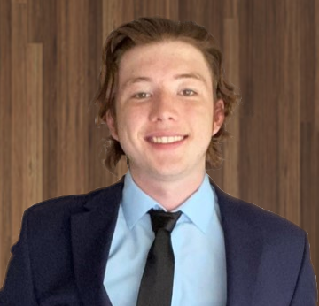
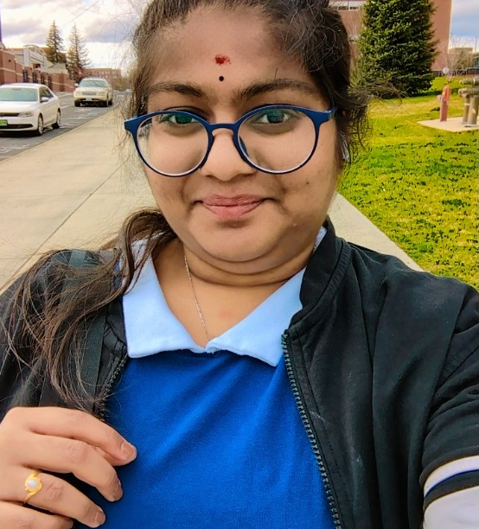
Thank you
DEVEN BIEHLER
SAI KOLAGANI
deven.biehler@wsu.edu
s.kolagani@wsu.edu
Notes:
Thank you for watching our presentation.

Slide 17
Bibliography
Feng, Yifan, Haoxuan You, Zizhao Zhang, Rongrong Ji, and Yue Gao. "Hypergraph neural networks." In Proceedings of the AAAI conference on artificial intelligence, vol. 33, no. 01, pp. 3558-3565. 2019.
Xiang, Sheng, Mingzhi Zhu, Dawei Cheng, Enxia Li, Ruihui Zhao, Yi Ouyang, Ling Chen, and Yefeng Zheng. "Semi-supervised credit card fraud detection via attribute-driven graph representation." In Proceedings of the AAAI Conference on Artificial Intelligence, vol. 37, no. 12, pp. 14557-14565. 2023.
Gao, Yue, Yifan Feng, Shuyi Ji, and Rongrong Ji. "HGNN+: General hypergraph neural networks." IEEE Transactions on Pattern Analysis and Machine Intelligence 45, no. 3 (2022): 3181-3199.
Datasets:
https://www.reddit.com/r/datasets/comments/3bxlg7/i_have_every_publicly_available_reddit_comment/
https://github.com/YingtongDou/CARE-GNN
Notes:
Thank you for watching our presentation.

Slide 18
TIMELINE
Deploy strategic networks with compelling e-business needs
SEP 20XX
Synergize scalable e-commerce
NOV 20XX
Disseminate standardized metrics
Coordinate e-business applications
MARCH 20XX
Foster holistically superior methodologies
MAY 20XX
JAN 20XX

Slide 19
PLAN FOR PRODUCT LAUNCH
PLANNING
Synergize scalable e-commerce
MARKETING
Disseminate standardized metrics
DESIGN
Coordinate e-business applications
STRATEGY
Foster holistically superior methodologies
LAUNCH
Deploy strategic networks with compelling e-business needs
1
2
3
4
5

